Slide 1
Level 3 – Management: Implementing DoCRA Process / Analytics
Combining these two views together (Risk Quantity & Risk Magnitude) provides decision makers insights about the security program
This combination shows decreasing Risk Quantity and decreasing Risk Magnitude, translating to an On Target Effective Program
Program Health – Trending Translator
Quantity
On Target Effective Program
Quantity
More
Resources
are Needed
Magnitude
Magnitude
Quantity
Effective Program More Resources are Needed
Quantity
A Different
Focus
Is Needed
Magnitude
Magnitude

Slide 2
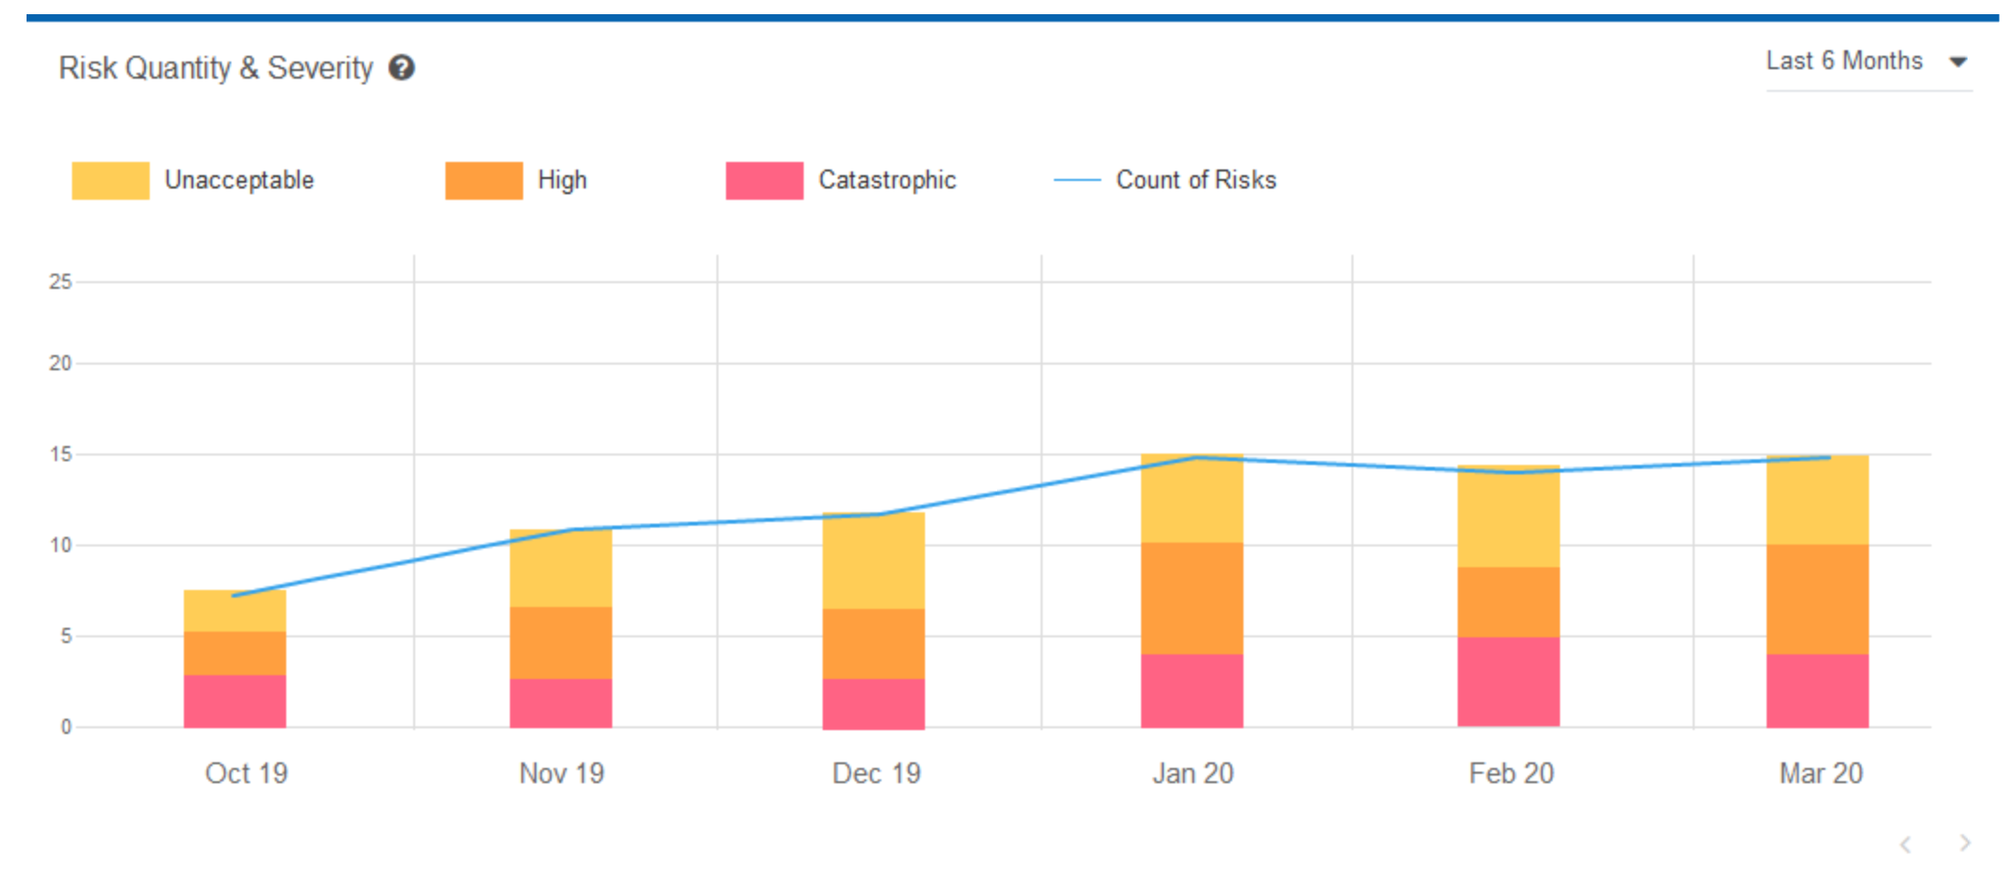
Level 3 – Management: Implementing DoCRA Process / Analytics
Combining these two views together (Risk Quantity & Risk Magnitude) provides decision makers insights about the security program
This combination shows increasing Risk Quantity and decreasing Risk Magnitude, translating to an Effective Program More where Resources are Needed
Program Health – Trending Translator
Quantity
On Target Effective Program
Quantity
More
Resources
are Needed
Magnitude
Magnitude
Quantity
Effective Program More Resources are Needed
Quantity
A Different
Focus
Is Needed
Magnitude
Magnitude

